Slide 3
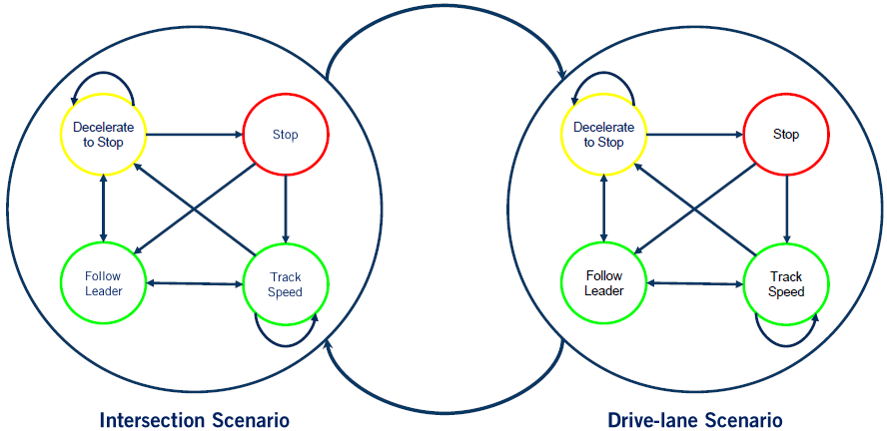
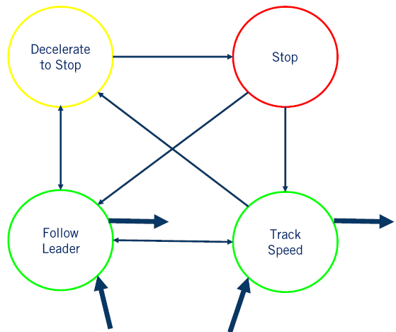
DELETE Handling Multiple Scenarios with Hierarchical FSM
Each driving scenario is modeled as a super-state, which contains a low-level FSM for the scenario.
(Each low-level FSM is specific for the scenario, e.g., the two FSMs in the figure have different trigger conditions not shown)
Exit
transitions
Entry transitions

Slide 4
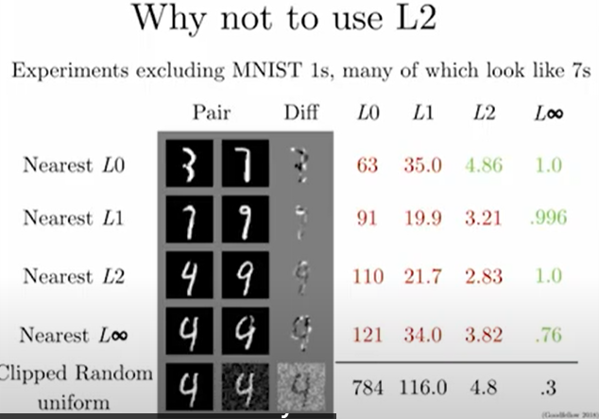
Defense Against the Dark Arts
https://www.youtube.com/watch?v=KNDkaVZwmg4&list=PL0pRF4xvoD0liEIWyJ6kmXqGT7nbr2L3u&index=11
Diagonal is minimum norm. Ideally, we want norm distance to be large for class-changing perturbations, small for random noise, like Linfty. But adding random noise leads to L2 norm 4.8, bigger than many class-changing perturbations. NG.
L2 norm cannot detect/permits change of a few pixels largely, which is likely to change the class.
We can make L2 distance big while still preserving the class

Slide 5
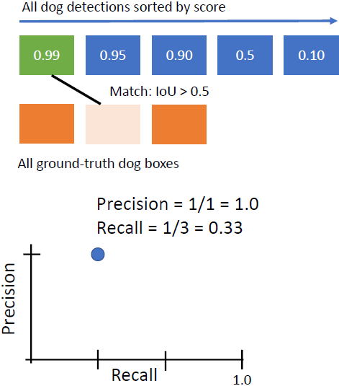
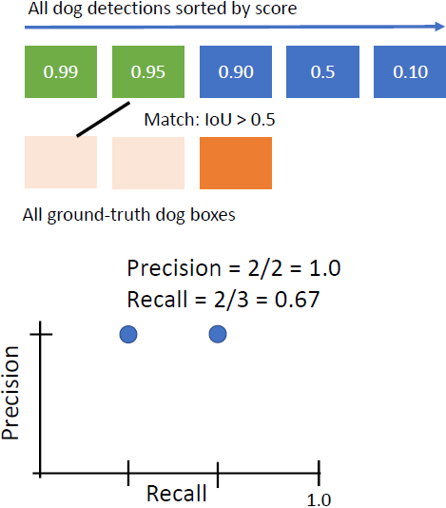
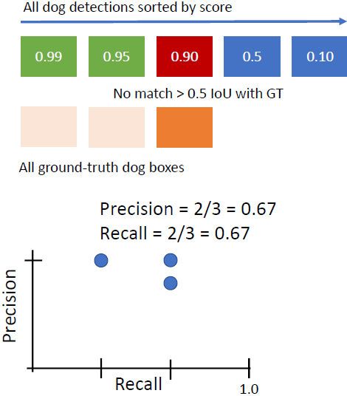

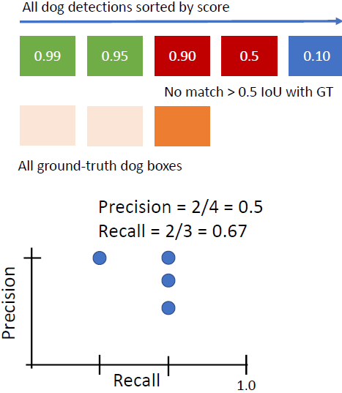
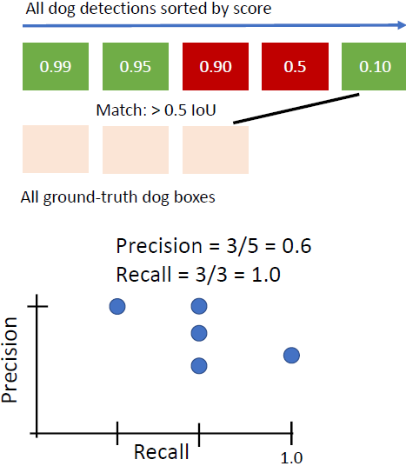
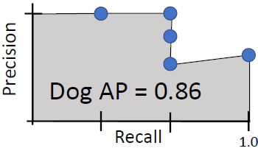
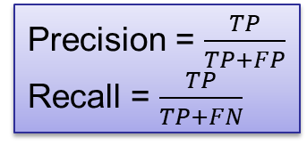
If you have a 3rd GT box that is not matched by any detection, then it is FN. But I don’t see any possible TN
FN=2 | TN=0
TP=1 | FP=0
FN=1 | TN=0
TP=2 | FP=0
FN=1 | TN=0
TP=2 | FP=1
FN=1 | TN=0
TP=2 | FP=2
FN=0 | TN=0
TP=3 | FP=2
Precision = $\frac{TP}{TP+FP}$
Recall = $\frac{TP}{TP+FN}$

Slide 6
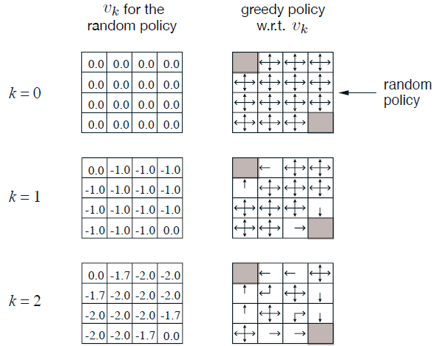
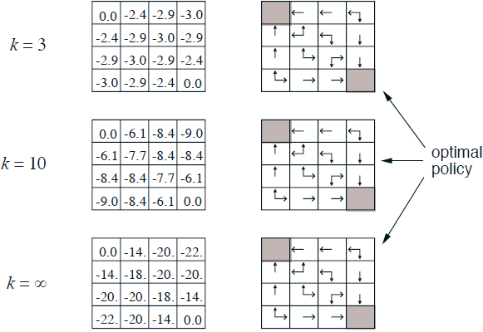
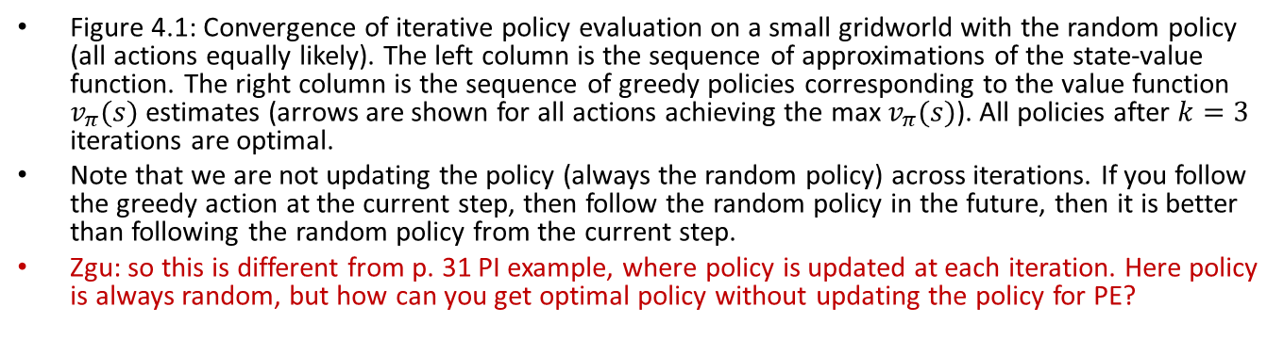
Iterative Policy Evaluation Results
Figure 4.1: Convergence of iterative policy evaluation on a small gridworld with the random policy (all actions equally likely). The left column is the sequence of approximations of the state-value function. The right column is the sequence of greedy policies corresponding to the value function $v_{π}(s)$ estimates (arrows are shown for all actions achieving the max $v_{π}(s)$). All policies after $k=3$ iterations are optimal.
Note that we are not updating the policy (always the random policy) across iterations. If you follow the greedy action at the current step, then follow the random policy in the future, then it is better than following the random policy from the current step.
Zgu: so this is different from p. 31 PI example, where policy is updated at each iteration. Here policy is always random, but how can you get optimal policy without updating the policy for PE?
Notes:
, and the numbers shown are rounded to two significant digits

